Slide 1
Offenders related to the rape victims
Q2Offenders relation to the rape victim
Query:-
SELECT Area_Name,sum(No_of_Cases_in_which_offenders_were_Other_Known_persons) as known_Person,
sum(No_of_Cases_in_which_offenders_were_Neighbours) as Neighbours,
sum(No_of_Cases_in_which_offenders_were_Relatives) as Relatives,
sum(No_of_Cases_in_which_offenders_were_Parentsclose_family_members) as family_members
from "21_Offenders_known_to_the_victim"
GROUP by Area_Name
ORDER by No_of_Cases_in_which_offenders_were_known_to_the_Victims DESC;

Slide 2
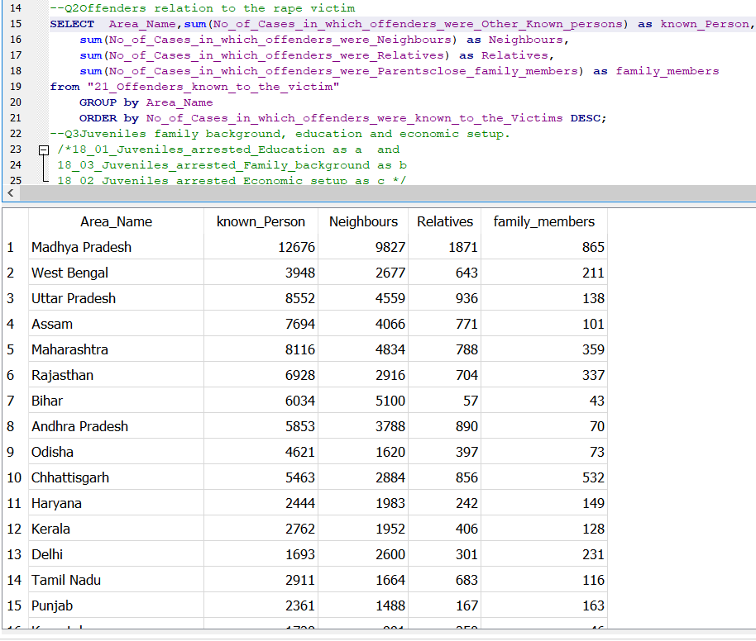
Our query screenshot:-

Slide 3
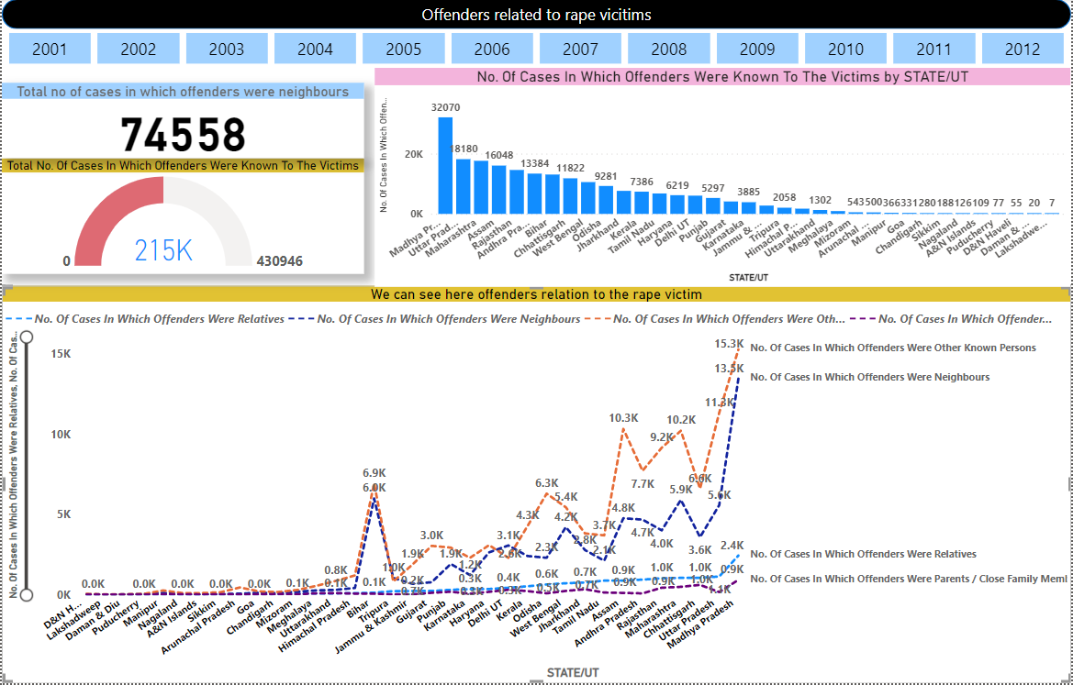
Conclusion:- 1.Madhya Pradesh show the maximum number of Other known person ,Neighbours ,Relatives, Close family members for related to rape victims.

